Slide 1
Tuesday 6th July 2021
English tasks:
Handwriting, writing task, reading task.

Slide 2
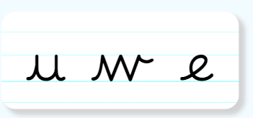
Handwriting
Can you practise the letters u, w and e.
Look on the letterjoin website to see how to form them correctly.
https://letterjoin.co.uk Then click on easy letters second set
Username: lj8943
If you are using a laptop the password is: home
If using an ipad or tablet the password is: capital L (Make the shape of a capital L)

Slide 3
Can you knock my socks off with your neat writing?
Now that you have practised your letters on letterjoin can you practise on a piece of paper?
Can you send a picture of your writing to me?
s.hiley@worthvalleyprimary.co.uk

Slide 4
Can I write a recount of my trip to Hesketh Farm?
On Friday you all went on an exciting trip to Hesketh Farm. I would love to hear all about it. What did you do there? What was your favourite part?
The next few slides have some top tips for writing recounts.

Slide 5
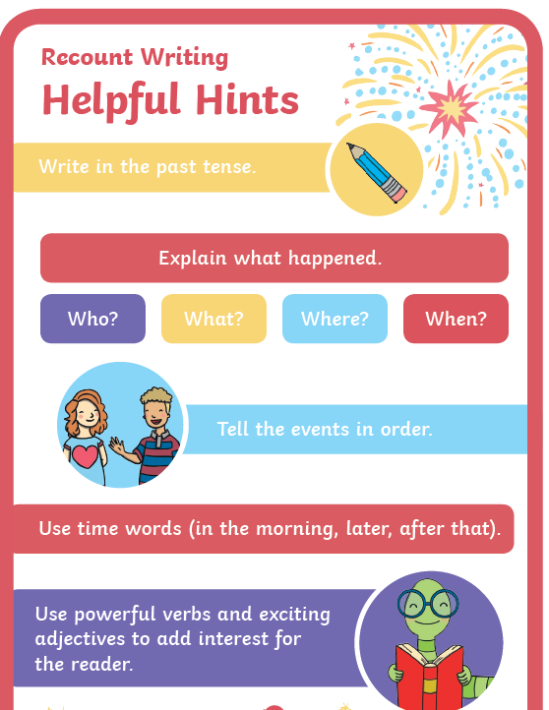
Writing Task
Top tips for writing a recount
First
then
after that
next
finally

Slide 6
Writing Task:
Here is an example of a recount

Slide 7
Writing task: It is up to you how you would like to complete this task. 1:You could write it on a piece of paper at home and email me a picture of your work. 2: You could type this on to purple mash. I have sent you a 2Do task for this. Remember to save your work and hand it in so I can see it.

Slide 8
Reading task:
Can you read this poem a few times to build fluency?
Can you read with expression?
Can you learn some of the poem and read it off by heart?

Slide 9
Remember I love to see your work so please email pictures to me at:
s.hiley@worthvalleyprimary.co.uk

