Slide 1
RE
Forgiveness
Year One
RE | Year 5 | Forgiveness | What Is Forgiveness? | Lesson 1 of 6

Slide 3
What Is Forgiveness?
forgiveness
With your talk partner, think about this word and what you think it means. Try and give some examples of forgiveness to help you to explain your understanding of the word. You will share your ideas with the class.

Slide 4
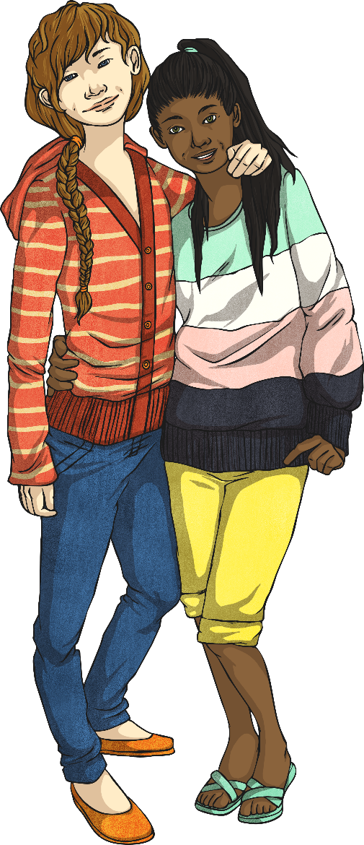
What Is Forgiveness?
Forgiveness (noun) is defined as:
the action or process of forgiving or being forgiven
(Oxford Dictionary)
To forgive (verb) is defined as:
to stop feeling angry or resentful towards (someone) for an offence, flaw or mistake.
(Oxford Dictionary)

Slide 5
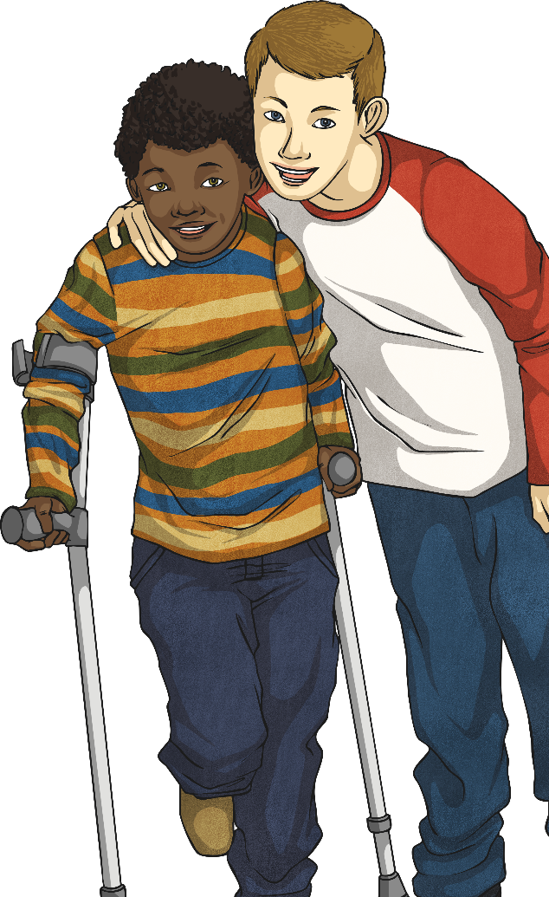
Understanding Forgiveness
Forgiving means to change the way you feel about something that has happened or has been done to you.
To consolidate our understanding of this, let’s explore how forgiveness is different from the following words:
condoning
forgetting
excusing

Slide 6
Understanding Forgiveness
Split your group into three pairs to work on a word each. Look up the dictionary definition of the word and prepare to explain to the rest of the group how the word is different from forgiving.
Pair 1: Look up the definition of condoning.
Pair 2: Look up the definition of forgetting.
Pair 3: Look up the definition of excusing.
Remember to decide how your word is different from forgiving.

Slide 7
Understanding Forgiveness
As you will have found out, the words have very different meanings.
Condoning
Condoning is accepting and allowing something which is wrong. Forgiving is not saying that bad behaviour is acceptable, but is saying that you no longer feel angry about it.
Forgetting is when you do not remember something. This is different from forgiving because when forgiving something, you are likely to remember it but are no longer resentful or wanting to punish the offender any more.
Forgetting
Excusing is when you try to give reasons why someone is less to blame for their actions. When you forgive, you are not analysing how much the person is at fault but you are saying you accept something happened and are letting go of the hurt caused.
Excusing

Slide 8
The Feelings of the Forgiver and the Forgiven
We will explore, through drama, the feelings involved when someone forgives another person. Read the quote on your Forgiveness Group Drama Activity Sheet.
Once you have discussed the quotation, work together to act out the situation described.
How do the characters in your drama feel when they are forgiven?
How do they feel when they forgive someone?
How will the situation end?

Slide 9
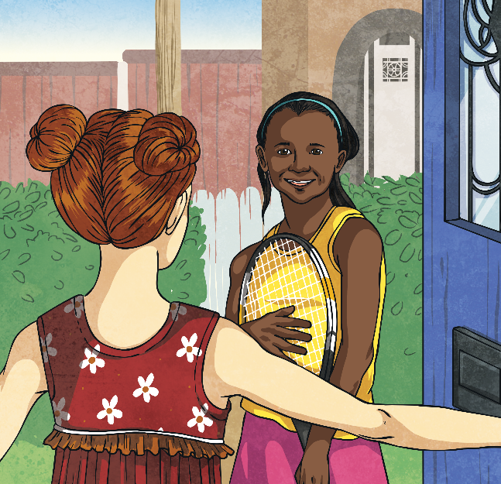
Reflecting on Forgiveness
After you have worked on the drama activity with your group, you should take some time on your own to reflect about the feelings involved when people forgive and when they are forgiven.
Complete the Reflecting on Forgiving Activity Sheet.

Slide 10
Quotations about Forgiveness
Through our drama work today, we have heard some thought-provoking quotations about forgiveness.
“When one forgives, two souls are set free.”
Unknown
“The weak can never forgive. Forgiveness is an attribute of the strong.”
Mahatma Ghandi
“Friendship flourishes at the fountain of forgiveness.”
William Arthur Ward
“When a deep injury is done to us, we never heal until we forgive.”
Nelson Mandela
“You do not do evil to those who do evil to you, but you deal with them with forgiveness and kindness.”
Prophet Muhammad (Peace Be Upon Him)

Slide 11
Quotations about Forgiveness
Do you think that when someone forgives, they are helping the person who has done wrong or helping themselves more?
Share what you think about this with your talk partner.
What do you think about this quotation by Buddha?
“Holding on to anger is like drinking poison and expecting the other person to die.”
Share what you think with your talk partner.
What does it mean? Do you agree?

