Slide 1
Phonics and Reading at Worth Valley Primary School

Slide 2
Phonics and Early Reading
Welcome to our meeting
Part 1 – information about how we teach phonics
Part 2 – information about how we teach reading

Slide 3
New DFE Guidance for Early Reading and Phonics
The journey to independent reading and writing begins with Phonics
littlewandlelettersandsounds.org.uk
Why Little Wandle?
Excellent training for all staff to ensure consistency,
Every aspect of phonics and reading included in a detailed, thorough and
systematic approach,
Engaging resources without distracting from the learning,
Comprehensive system for identifying and supporting children requiring
extra help and useful support for parents.
Notes:
Government changes mean a change (for the better) in how we teach phonics and reading at school - make sure there is consistency throughout
Early reading is the stage where children are learning to become fluent readers through the use of phonics

Slide 4
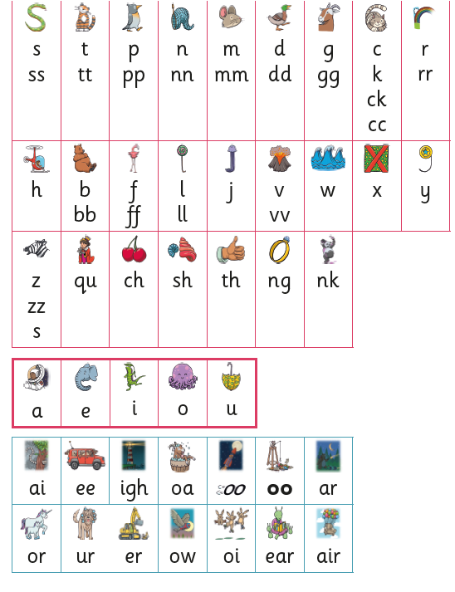
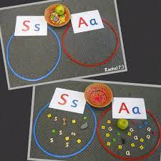
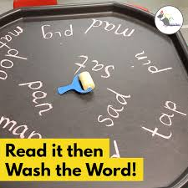
How we teach phonics
Daily short sessions
Specific order of teaching
must
Correct pronunciation
is vital - Videos on LW
https://www.littlewandlelettersandsounds.org.uk/resources/for-parents/
Synthetic phonics
Repeated practice
Revisit previously
taught sounds at
start of each lesson
Practice makes
permanent

Slide 5
Notes:
Phonemes taught in order start to read words asap
LW has a picture pnemonic to help children remember the phoneme/grapheme

Slide 6
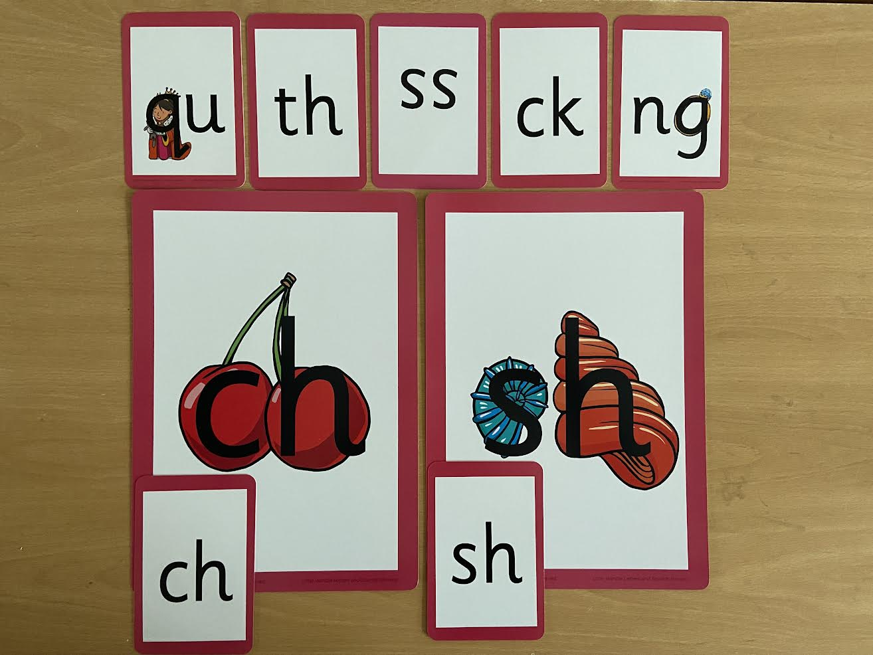
Notes:
Early digraphs mostly consonant digraphs – 2 letters 1 sound

Slide 7
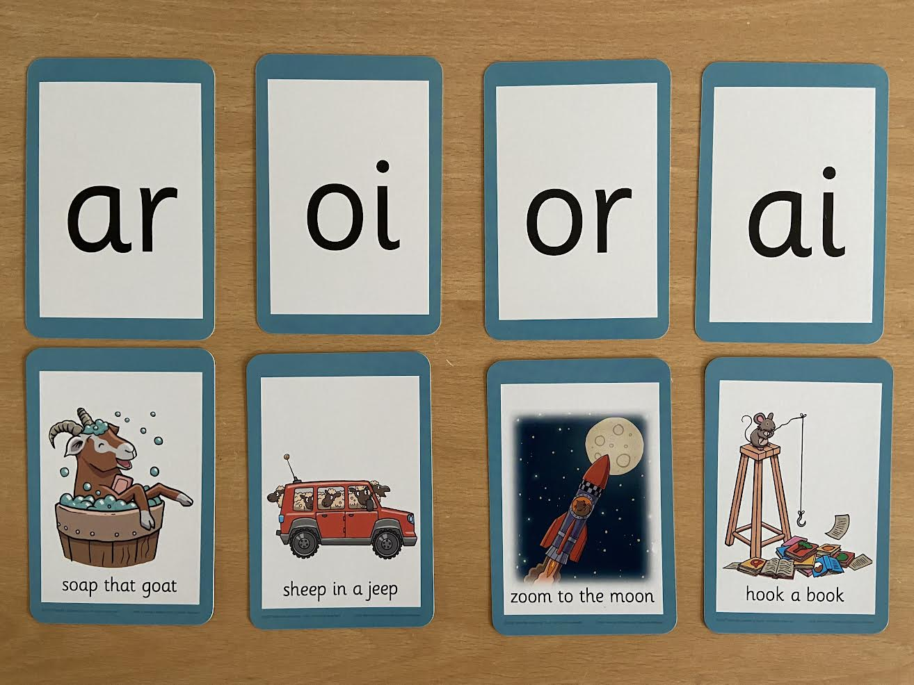
Notes:
Vowel digraphs taught with a short caption to help children remember
Also trigraphs igh, air

Slide 8
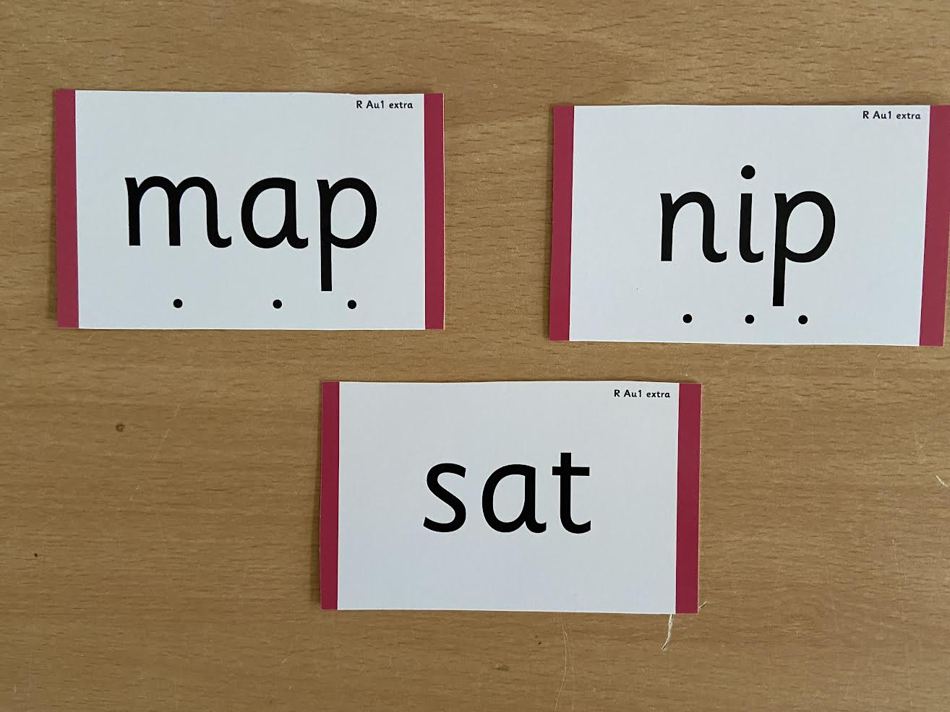
Notes:
During phonics lessons we use Sound buttons so we can sound talk and blend to read

Slide 9
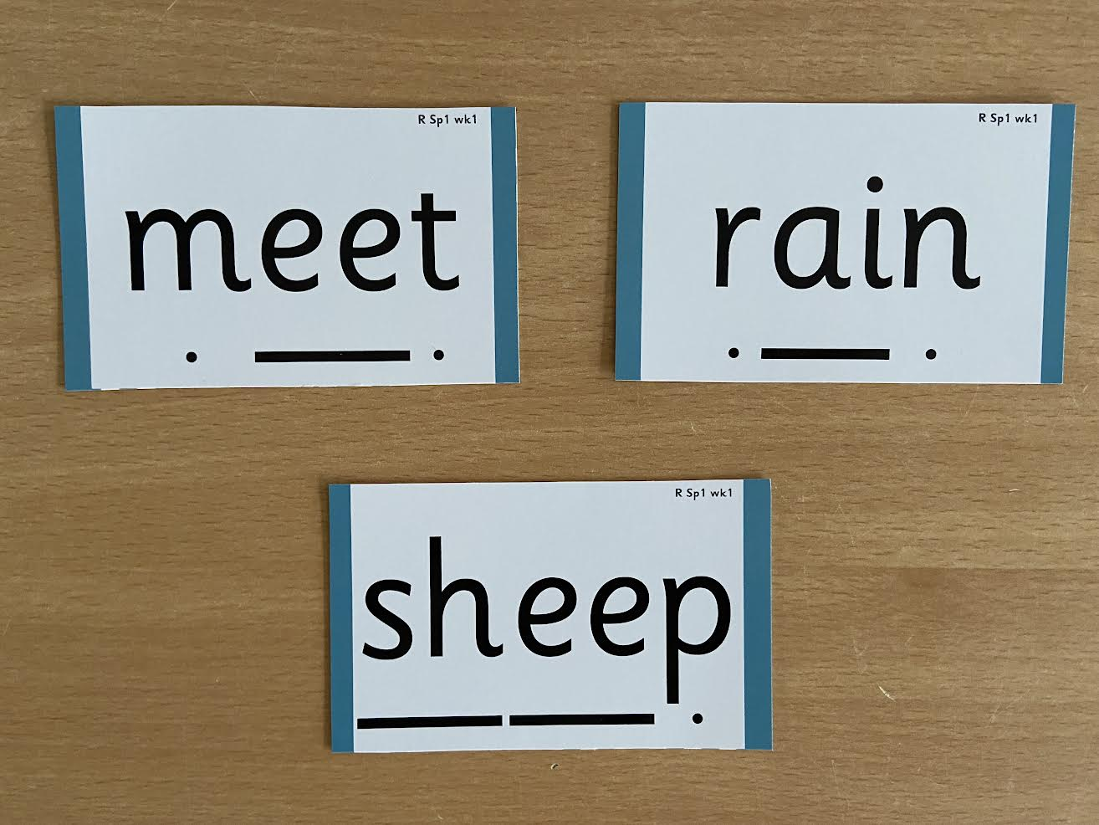
Notes:
Digraphs have a zip to sound talk and blend

Slide 10
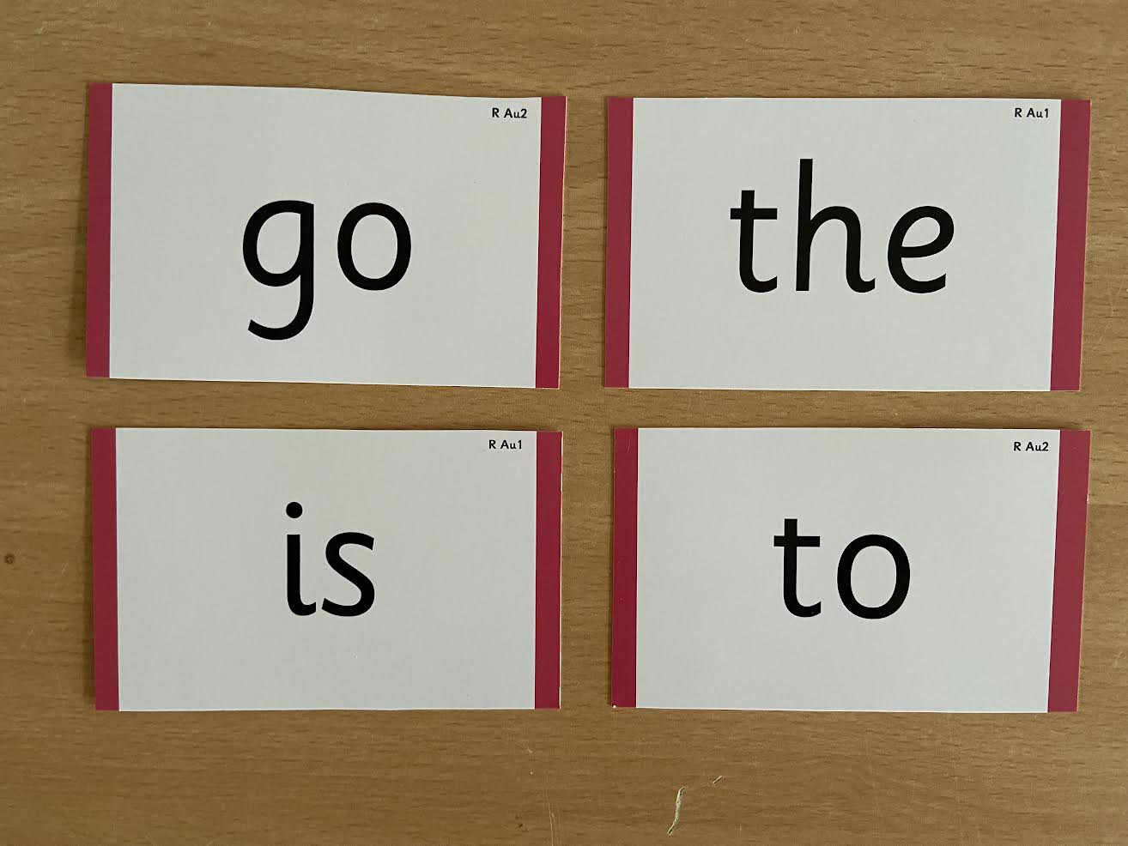
Notes:
Words that do not follow the rules and cannot be decoded – tricky words/ exception words
Chn are taught what part of the word is tricky

Slide 11
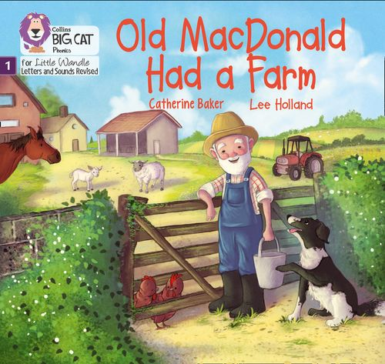
Once children have a secure knowledge of a number of
GPCs (Grapheme Phoneme Correspondences)
and are confidently blending, they will be ready for
reading books
Prior to this they may have wordless books which develop great language skills and teach children the layout of books and how to handle books

Slide 12
Reading
Learning to read should be
a positive experience
We want children to
love reading
We want children to read for pleasure
Reading should be
enjoyable
Reading underpins children’s access to the curriculum
and clearly impacts on their achievement
Notes:
We all know how important learning to read is and the impact it has on a childs success - it has to be a positive experience
Whats the reality? Reluctant to read because they find it hard
Frustration stress tears – that’s just the parents
Important to look at the big long term picture

Slide 13
How we teach reading
Reading practice sessions are :
Books are :
matched to children’s
secure phonic knowledge
and word reading
Timetabled 3 times a week
read three times
Taught by trained teacher or
teaching assistant
sent home after the third
reading session
Taught in small groups
Notes:
Quite a big difference to how reading was previously taught

Slide 14
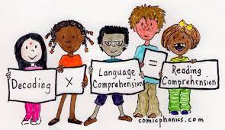
Reading Practice Books carefully matched so children can read
fluently and independently
3 Reads – each one begins with some quick sounds and words practice
Decoding
Prosody
(intonation, expression)
3. Comprehension
When children take their book home to read they should be 95% fluent
Please do not worry that a book is too easy – your child needs to develop
fluency and confidence in reading. Re-reading a book they have had before helps develop fluency – this is the goal.
Celebrate their success!!!

Slide 15
How will this work?
Children are assessed, then LW matches which books
Should be allocated for their secure phonic knowledge
Children will take their Reading Practice book home
The children keep the same Reading Practice book for the week
The books need to go home every night and
be returned the next day
Celebrate, praise, talk about the book with you child.
It only needs to be a short session.
Please make sure books are in book bags so that
we can reallocate books as required
Notes:
Children will not be changing book multiple times a week as previously
Reading groups will be set up so you will be notified of when your book will be sent home/ need to be back in school
Groups will change!

Slide 16
Big Cat Collins Reading books are carefully matched to children’s
secure phonic knowledge
Notes:
To reiterate - Children will not have books containing GPC’s they have not learned and are not secure with
Look at inside cover

Slide 17
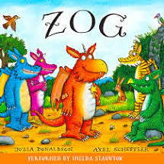
Shared Reading Books
To become lifelong readers, it is essential that they read for pleasure
Children may not be able to read this book independently but these books offer a wealth of opportunities for talking about the pictures and enjoying the story or information text.
Enjoy the book together and
foster a love of reading
“pair and share”

Slide 18
Shared Reading Books
Children will also bring home a ‘shared reading’ book each week.
These are specially selected books matched to the age group.
These can be shared together

Slide 19
What else can parents do?
Please look at the Little Wandle videos and guidance for parents
Support children in learning the alphabetic code
Let your child “show off” their reading to you and celebrate and praise all the way!
Share books with your children for pleasure
In the reading log- write down books you have shared at home such as at Bedtime.

Slide 20
Thank you for joining us

